Slide 1
A Conceptual Description of the PID Controller
by
Dennis M. (Mike) Briggs, Ph.D.
Continuing Lecturer, UCLA School of Engineering and Applied Science
Department of Electrical and ComputerEngineering

Slide 2
Scenario Setup
Imagine that you are in a car with Adaptive Cruise Control; that is, your car (the Host Vehicle) can either:
cruise automatically at the set speed that you ask for,
or
if you are following another slower car (the Lead Vehicle), can match the lower speed of that Lead Vehicle at a safe distance.

Slide 3
Scenario Setup (cont.)
Now, imagine that you are following a vehicle at 25 m/s (about 56 mph), with a cruise set speed of 30 m/s (about 67 mph). This means that the radar is working, keeping your speed 5 m/s below what you asked for (30 m/s).

Slide 4
Scenario Setup (cont.)
And, further, imagine that you want to maintain 2 seconds headway behind the Lead Vehicle. This leads to the following figure:
SLOWPOKE
SET POINT
HOST
VEHICLE
LEAD
VEHICLE
LEAD
VEHICLE
25 m/s
25 m/s
20 m/s
25 m/s * 2 s = 50 m

Slide 5
Scenario Setup (cont.)
At this point, this Lead Vehicle changes lanes, and you now sense at 75 m the slowpoke that is going 20 m/s (about 50 mph).
SLOWPOKE
NEW SET POINT
HOST
VEHICLE
LEAD
VEHICLE
25 m/s
20 m/s
20 m/s * 2 s = 40 m
75 m
What should the Host Vehicle controller do?

Slide 6
What to Do?
Obviously, an error exists, because the Host Vehicle is not at the set point. The controller could:
Command a speed increase to catch up to the set point rapidly
Continue the current speed until the set point is nearly reached, then slow down rapidly
Gradually slow the Host Vehicle to 20 m/s, just as the set point is reached.
SET POINT
HOST
VEHICLE
LEAD
VEHICLE
25 m/s
20 m/s
20 m/s * 2 s = 40 m
75 m

Slide 7
Controller Types
Now, #1 is rather like a proportional controller.
And #2 and #3 are like a derivative controller. We’ll get to the integral controller in a minute.
P
Command a speed increase to catch up to the set point rapidly
Continue the current speed until the set point is nearly reached
Gradually slow the Host Vehicle to 20 m/s, just as the set point is reached.
D
SET POINT
HOST
VEHICLE
LEAD
VEHICLE
25 m/s
20 m/s
20 m/s * 2 s = 40 m
75 m

Slide 8
Proportional Controller
So how is #1 like a proportional controller? Look at this calculation:
Desired Headway Distance = Lead Vehicle Speed * 2 s = 20 m/s * 2 s = 40 m
Correction Signal or Speed Change Command = Kp * Headway Distance Error
Kp must be > 0 for stability, so Speed Change Command > 0
The Speed Change Command is proportional to the error. Hence, its name
SET POINT
LEAD
VEHICLE
20 m/s
SET POINT
HOST
VEHICLE
LEAD
VEHICLE
25 m/s
20 m/s
20 m/s * 2 s = 40 m
20 m/s * 2 s = 40 m
75 m

Slide 9
So why is K_{p}>0?
Because if it were less than zero, Speed Change Command would be negative, forcing the car to slow down, all the way to zero. The system would be unstable. So K_{p} must be > 0.
Note: it’s all in how you define your error.
If error had been defined as h_{r}-R, then K_{p}<0.

Slide 10
So What Happens?
The proportional controller generates a positive Speed Change Command that causes the Host Vehicle to speed up.
Basically, the proportional controller is saying, “Hey! I’m behind where I want to be! I’ve got to speed up to get to the set point.”
So, in the sense of position, the proportional controller is rather SMART.

Slide 11
But Here’s Another Thing
The proportional controller ignores the fact that the Host Vehicle is already traveling faster than the Lead Vehicle, and will catch up to the set point even if nothing changes.
So, in the sense of velocity differences, the proportional contoller is rather DUMB.
But the derivative controller is well aware of the velocity differences.

Slide 12
Derivative Controller
In fact, the velocity difference is all the derivative controller is aware of.
The derivative controller looks at the derivative of the error signal.

Slide 13
Derivative Controller
Derivative of error signal:
Derivative of Headway Distance Error = Range Rate = 20 m/s – 25 m/s = -5 m/s
Correction Signal or Speed Change Command = K_{d} * Derivative of Headway Distance Error
K_{d} must be > 0, so Speed Change Command < 0.

Slide 14
What’s Happening Here?
The derivative controller is saying,
“Hey! I’m going faster than the car ahead. I’d better slow down!”
So, in the sense of velocity, the derivative controller is rather SMART.
In effect, the derivative controller is predicting what will come next.

Slide 15
PD Summary

Slide 16
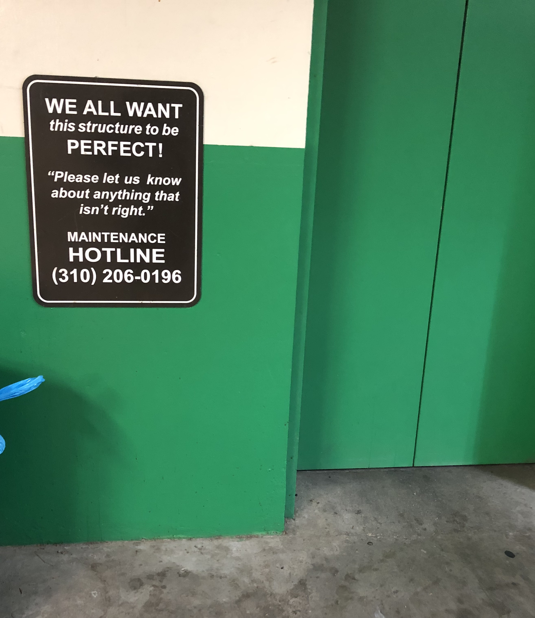
Integral Controller
An integral controller is very A.R.
It looks for ultimate accuracy, at the risk of creating too-fast reaction times and loss of stability margin.
It works on the integral of the error signal

Slide 17
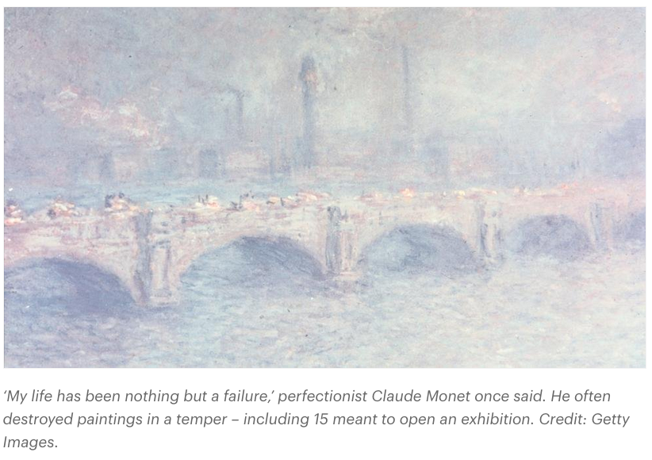
Integral Controller
BBC Future, “The Dangerous Downsides of Perfectionism“

Slide 18
Integral Controller
Consider a constant offset from the required headway point.
(error)=constant
What’s the integral of a constant?

Slide 19
Integral Controller
Consider a constant offset from the required headway point.
(error)=constant
What’s the integral of a constant?
A ramp!
The Integral Controller says, “Hey! I’ve been a little inaccurate for way too long here! It’s time to do something about it!”

Slide 20
Integral Controller
K_{i} is positive, because we need a speed increase if we are behind the required point [ (R-h_{r})>0].
In a highly dynamic application, its use is limited because
The required condition doesn’t stay in one place very long.
Really, really precise position is often not necessary.
It's easy to set the K_{i} gain too high and destabilize the system.

Slide 21
Summary

Slide 22
NOW…

Slide 23
Appliction to Project
What’s the sign of K_{p}?
What’s the sign of K_{d}?
- error
error
+ error
- steering
+ steering

Slide 24
Sign of K_{p}
Sign of K_{p}: NEGATIVE, because the displacement error is positive, and the steering must be negative to correct the error.
- error
error
+ error
- steering
+ steering

Slide 25
Sign of K_{d}
NEGATIVE, because the velocity error is negative (it’s making the displacement error smaller), and the steering must be positive to make the derivative of the error less negative.
- error
error
+ error
- steering
+ steering

Slide 26
IOW
When the car is moving TOWARD the target:
P term is (+)
D term is (−)
P and D disagree!
What about when the car is moving AWAY FROM the target?

Slide 27
The Other 3 Possibilities
TOWARD
AWAY FROM
AWAY FROM
−e +e
−steer +steer
−e +e
−steer +steer
−e +e
−steer +steer
e₁= −10
e₂= −5
Δe=(−5) − (−10)=+5
(−K_{P})(−5) ➜ +P term
(−K_{D})(+5) ➜ −D term
e₁=+5
e₂=+10
Δe=(+10) − (+5)=+5
(−K_{P})(+10) ➜ −P term
(−K_{D})(+5) ➜ −D term
e₁= −5
e₂= −10
Δe=(−10) − (−5)= −5
(−K_{P})(−10) ➜ +P term
(−K_{D})(−5) ➜ +D term
DISAGREE
AGREE
AGREE

Slide 28
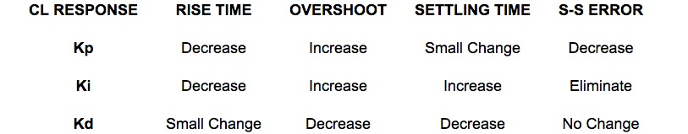
PID Summary
From http://www.engin.umich.edu/group/ctm/PID/PID.html#characteristics

Slide 30
Quiz Time!
What’s the sign of K_{p}?
What’s the sign of K_{d}?
- error
error
+ error
- steering
+ steering
“bicycle” model of NatCar

